Slide 1

Brand Research & Insights
Thunderbird Net Impact Team
December 2013

Slide 2
Table of Contents
Market Problem
Market Overview
Research Process
Market Insights
Key Takeaways
Further Research

Slide 3
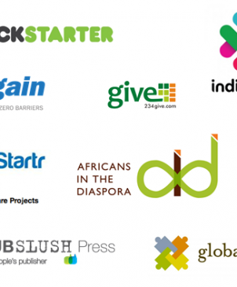
Overall Market Problem
Low barriers to entry
  Many sites offering similar service and functionality
  New websites enter market at destabilizing pace
Low digital differentiation
  Limited ability to truly differentiate and add additional value to fundraising service
  Service based, purely digital companies have low customer points of contact and suffer constant erosion of market share and no brand loyalty

Slide 4

Razoo’s Opportunities
Discover exactly what drives people to certain campaigns and engage
Understand what specific strategic marketing advantages can be developed against competitors
Develop plans for future and deeper research providing better insights into long-term brand strategy, increasing customer loyalty

Slide 5
Market Overview
There are 4 Categories of Crowd funding Platforms¹
Equity Based
Fastest Growing Category
Lending Based
Like the Equity based crowd funding for financial return – in terms of fixed payments
Smallest in terms of number of platforms
Reward Based
Largest category in terms of overall number of CFPs
Donation Based
Raises the largest sum of money per campaign
Crowd funding for financial return- in terms of equity
Crowd funding in which the funder expects a non-financial reward such as a token or a limited release of a product.
Crowd funding where the funders donate to causes they want to support with no expected compensation.
Donation based crowd funding for arts and performing arts projects drive less funding.

Slide 6
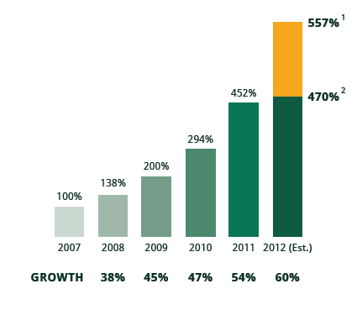

Number of CFPs Worldwide
536 – Estimated number of CFPs by December 2012.
452 – the total number of CFPs by April 2012
More than 1 million successful campaigns were run by CFPs worldwide in 2011-2012.

Slide 7
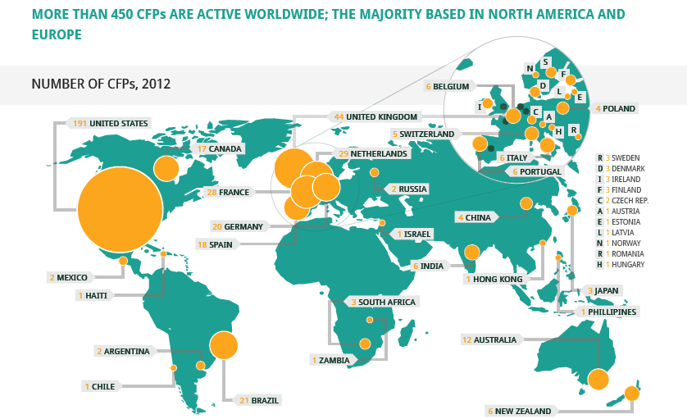
Representation of CFPs Worldwide

Slide 8
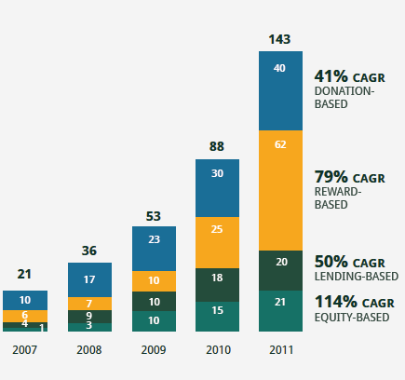
Growth in number of CFPs by category
Reward based category is the largest in terms of number of CFPs growing at a high rate of 79% CAGR.
Donation based and Lending based are growing at similar pace, significantly lower than Reward based category.
Equity based crowd funding shows the fastest growth rate at 114%

Slide 9
Donation and Reward Based Crowd Funding
Draws lower levels of funds per project compared to Equity and Lending based
Of the total funds raised :
  63% are allocated to projects that draw less than $5000
  27% are allocated to projects that draw between $5000 and $10000
  10% are allocated to projects that draw more than $10000

Slide 10
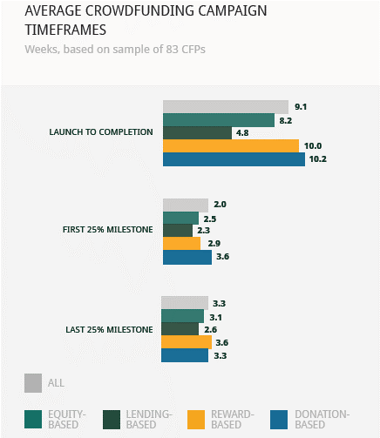
Time Taken from Launch to Completion
  Projects on Lending based platforms take about an average half of the time taken for projects on Donation and Equity based platforms
  Projects on Reward based platforms take an average about 10 weeks
  All platforms take similar time to reach the first and last 25% milestone
Source: ¹ Massolution Inc, www.crowdsourcing.org

Slide 11
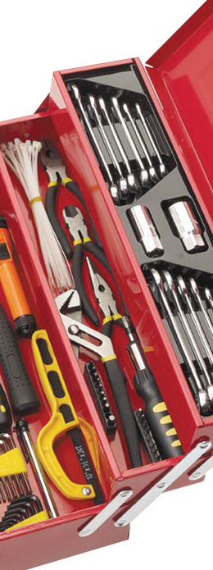
Research Tool Box
Research Tool | Outcome
Business Intelligence | Competitor Insights
General Market Analysis | Market Positioning Insights
Focus Group | Marketplace Perceptions, Needs and Preliminary Variables
Word Map Analysis | SEO and Preliminary Brand Insights
Digital Media Analysis | Website Traffic Drivers

Slide 12
Insight #1
Process – Focus Group
Result
Conducted a focus group with 11 participants
  Gathered perceptions of the fundraising industry
  Qualitative analysis of website usage for Razoo, Crowdtilt and Fundly
  Developed preliminary understanding of why people invest, variables for engagement
Cause vs. Relationship based donation
Homepage benefits from clear, detailed examples of past successful campaigns
Simple navigation, simple donation
Perception that Razoo targets middle aged demographic (31-40)
Razoo’s website ranks lower against Crowdtilt & Fundly

Slide 13
Insight #1

Slide 14
Insight #1
Qualitative Reactions To
Razoo’s Webpage
“Difficult to navigate the site. I can’t search for what I’m looking for.”
“None were inspiring or easy to navigate. I had to try too hard to figure out what was going on or where to go to give my money”
“Not as visually appealing as Fundly”
“I find the layout difficult to navigate”
“Projects not immediately visible. Worse than Fundly”
“The home page is not very detailed, hard to navigate across the website.”
“Difficult to easily navigate and find causes from homepage”

Slide 15
Insight #1

Slide 16
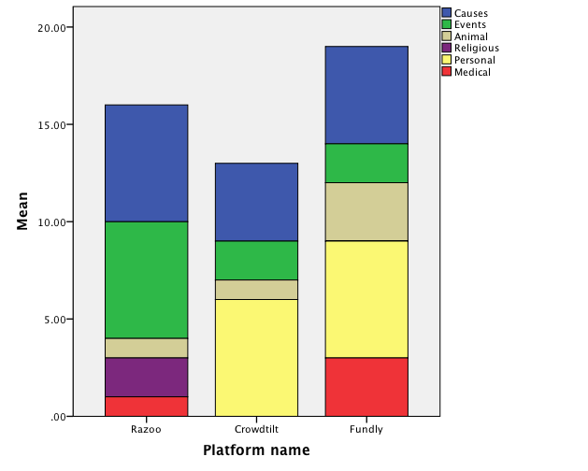
Insight #1
Feedback from the focus group on observed campaigns
  Indicates that Crowdtilt and Fundly have an apparent focal point on “personal” and “causes” campaigns
  Razoo has an apparent focal point on “events” and “causes”.
  Razoo is also the only platform to market “religious” campaigns

Slide 17
Insight #1
“I’ve never actually navigated myself onto a crowd funding website, just to the individual campaigns. Mostly campaign starters navigate to the front page, no?”
“I’m turned off when I see stupid projects that have no real meaningful purpose, I don’t trust the site”
“I just need really simple navigating, I invested in a friend’s campaign last week and I needed to create an account and sign in just to donate, then I got spammed later on with campaigns that were great but completely not relevant, I didn’t know them – no more spam”
“There is this one page I follow on Facebook about adopting puppies, which I can’t do, but if there was a button to donate on the page I would do it – just never thought about it”
“Crowdtilt’s homepage shows off example projects well and cleanly, Razoo doesn’t give me a good feeling for their projects, there are no details”

Slide 18
Insight #2
Process – Word Mapping
Result
Generated a word map of the most frequent words occurring on competitors’ websites
Useful to understand the market positioning of each brand
Basic understanding of SEO perceptions
Some competitors focus on the outcome rather than the process of donation itself – like Crowdtilt
  Focus on the value delivered, the end result of helping rather than the process of giving – the experience
  Keywords: Party, Healing, Friends, Animals, Community
All sites abuse the word funding and raise
  Consider ways of differentiating diction
  Demonstrates focus on the process not the outcome of fundraising
  Limit use of these fatigued words
    Possible point of brand differentiation?
    Ex. “Razoo doesn’t raise funds, it raises hopes”

Slide 19
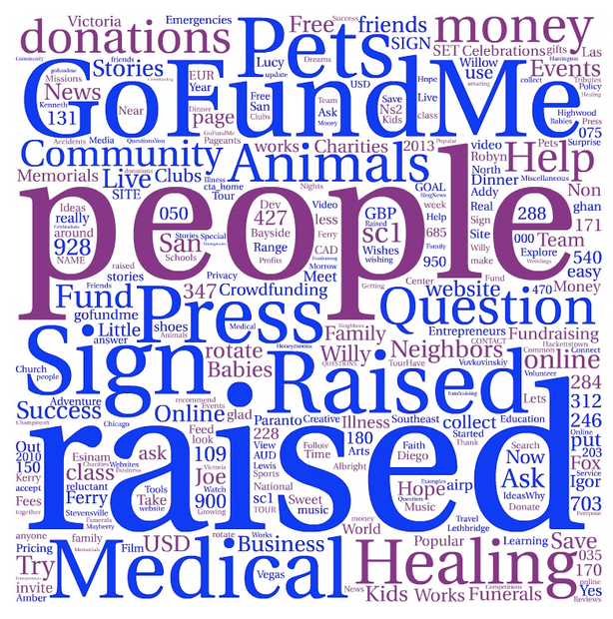
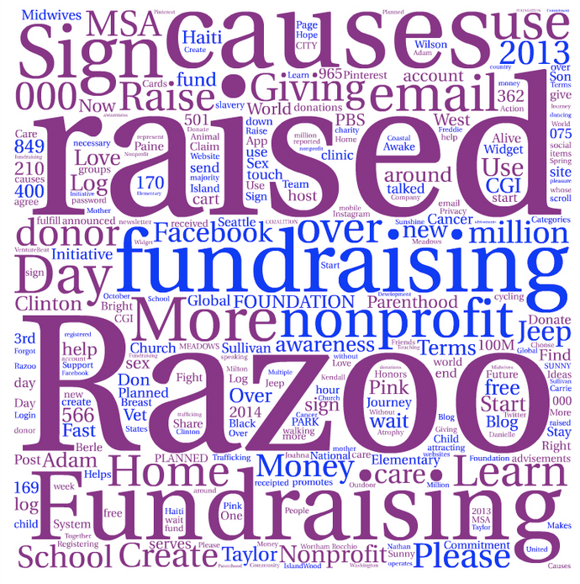
Insight #2
GoFundMe
Razoo

Slide 20
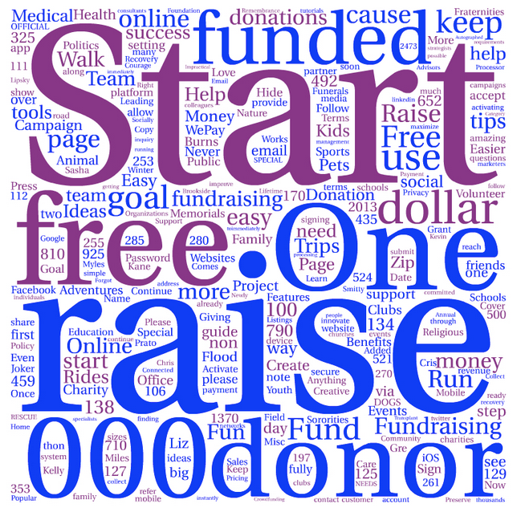
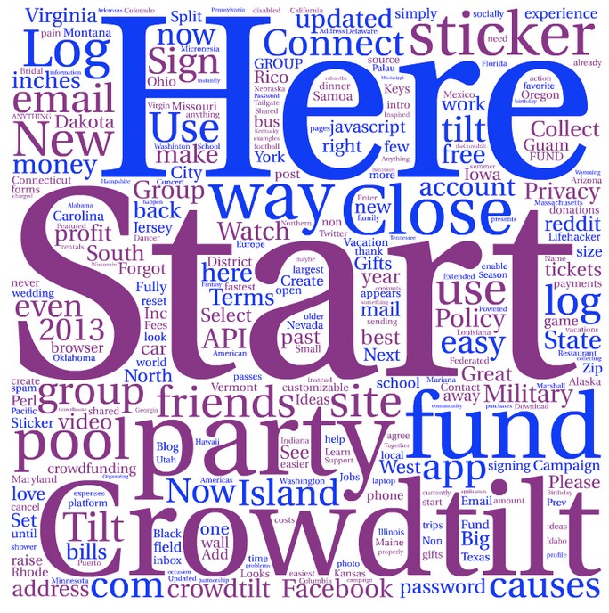
Insight #2
Fundly
Crowdtilt

Slide 21
Insight #3
Process – Statistical Analysis
Result
Gathered 2 months of Trackmaven data
Assessed usage of multiple forms of digital content
  Social Media, Email etc
Correlated types of content with website metrics
  Traffic, Page Rank, Klout Score
  What makes websites successful?
Still not specifically able to understand what drives engagement on a campaign level, lacking information to drive analysis
  What makes individual campaigns successful?
Performed statistical analysis to find what drives website metrics across 18 crowd funding platforms
  Twitter is the most influential social media platform
  Newsletters have low influence on monthly website visits
  Frequency of blog posts less important than how/where they are published or promoted
Mostly intuitive social media and website traffic conclusions
  Need to gather campaign metrics and success rates

Slide 22
Insight #3
Metric | Strongest Correlated Activities
KloutScore | TweetsPerDay, AverageRetweets
YouTubeSubscribers | FacebookPostsPerDay
MonthlyVisits | TwitterFollowers, TotalRecentEmailsSent
SitesLinkingIn | TwitterFollowers, KloutScore, YouTubeSubscribers, MonthlyVisits
BlogPostsPerDay | None

Slide 23
Insight #4
Process – Business Intel
Questions
Contacted several competitors about their marketing and branding strategy
Only managed full contact with a marketing manager from Fundly
Gained insights into their competitive strategies
Asked Fundly manager the following questions
  What value do you bring your customers?
  Do you have a market niche?
  How do you segment?
  What are your competitive advantages?

Slide 24
Insight #4
Fundly Responses
Result
Focused on Communities
  The small local/family stories drive donations
  They offer a personal connection
“System that works for us”
  Heavily collecting user data
  Developing insights on how to reach customers and promote successful campaigns
  Informing users how to design successful campaigns “pictures = x% success rate” etc
SEM is leveraged to determine market tendencies toward searches and buzz words.
They filter campaigns that only match their value statement of local
  They want to target “community outreach”
  Family and friends are key
Constantly update SEO to improve keyword drivers for their local target market
They rely deeply on data analysis to find trends for success
  They spread the wealth by informing users how to have most successful campaigns, how to contact donors
  Avg. Donation Impersonal stories - $20-$30
  Avg. Donation Personal stories - $70

Slide 25

Current Research Roadblocks
Limited Understanding of Field
  Newly growing industry
  Changing Customer Needs
  Low barriers to entry
Preliminary Research
  Variables for analysis still unclear
  What variables really drive usage?
  What do users need to “engage” with campaigns?
Developed Market Example: Beer
Variables of Analysis that drive sales
Bitterness, Hoppiness, Color & Smell

Slide 26

Key Takeaways & Recommendations
Razzo needs better collection and analysis of user data - investor behaviors and drivers
Main website focus on the outcome not process, homepage not navigable
Twitter drives website usage, how blog posts are published is important
Greater sensitivity to selecting campaigns to ensure relevance to Razoo’s values and brand
Additional deeper 2nd round research into brand loyalty, customer needs & niches, unique Razoo value and competitor positioning

Slide 27

Further Research Recommendations
Brand Driver Analysis
Internal / External Brand Valuation
  Does company and customer perception match up?
  Reveal gaps in current perceptions
Assess Razoo’s core strengths and values
  Does Razoo differentiate itself well enough?
  How can it better bring value to target customers?

Slide 28
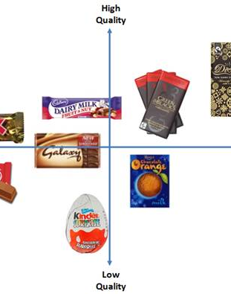
Further Research Recommendations
Brand Mapping
Develop Brand Mapping Questionnaire
Analysis of Competitors
  Benchmark Razoo against main competitors
  Select relevant characteristics important to customers
  Understand how Razoo is positioned compared to its competitors

Slide 29
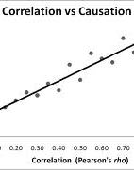
Further Research Recommendations
Correlation Study
Develop better understanding for which variables drive campaign engagement
Compare multiple possible variables (website traffic, Facebook, newsletters, campaign metrics) against campaign success rates and engagement metrics

