Slide 1
facebook
vs.
face-to-face
Capstone
By
Andrew Carson

Slide 2
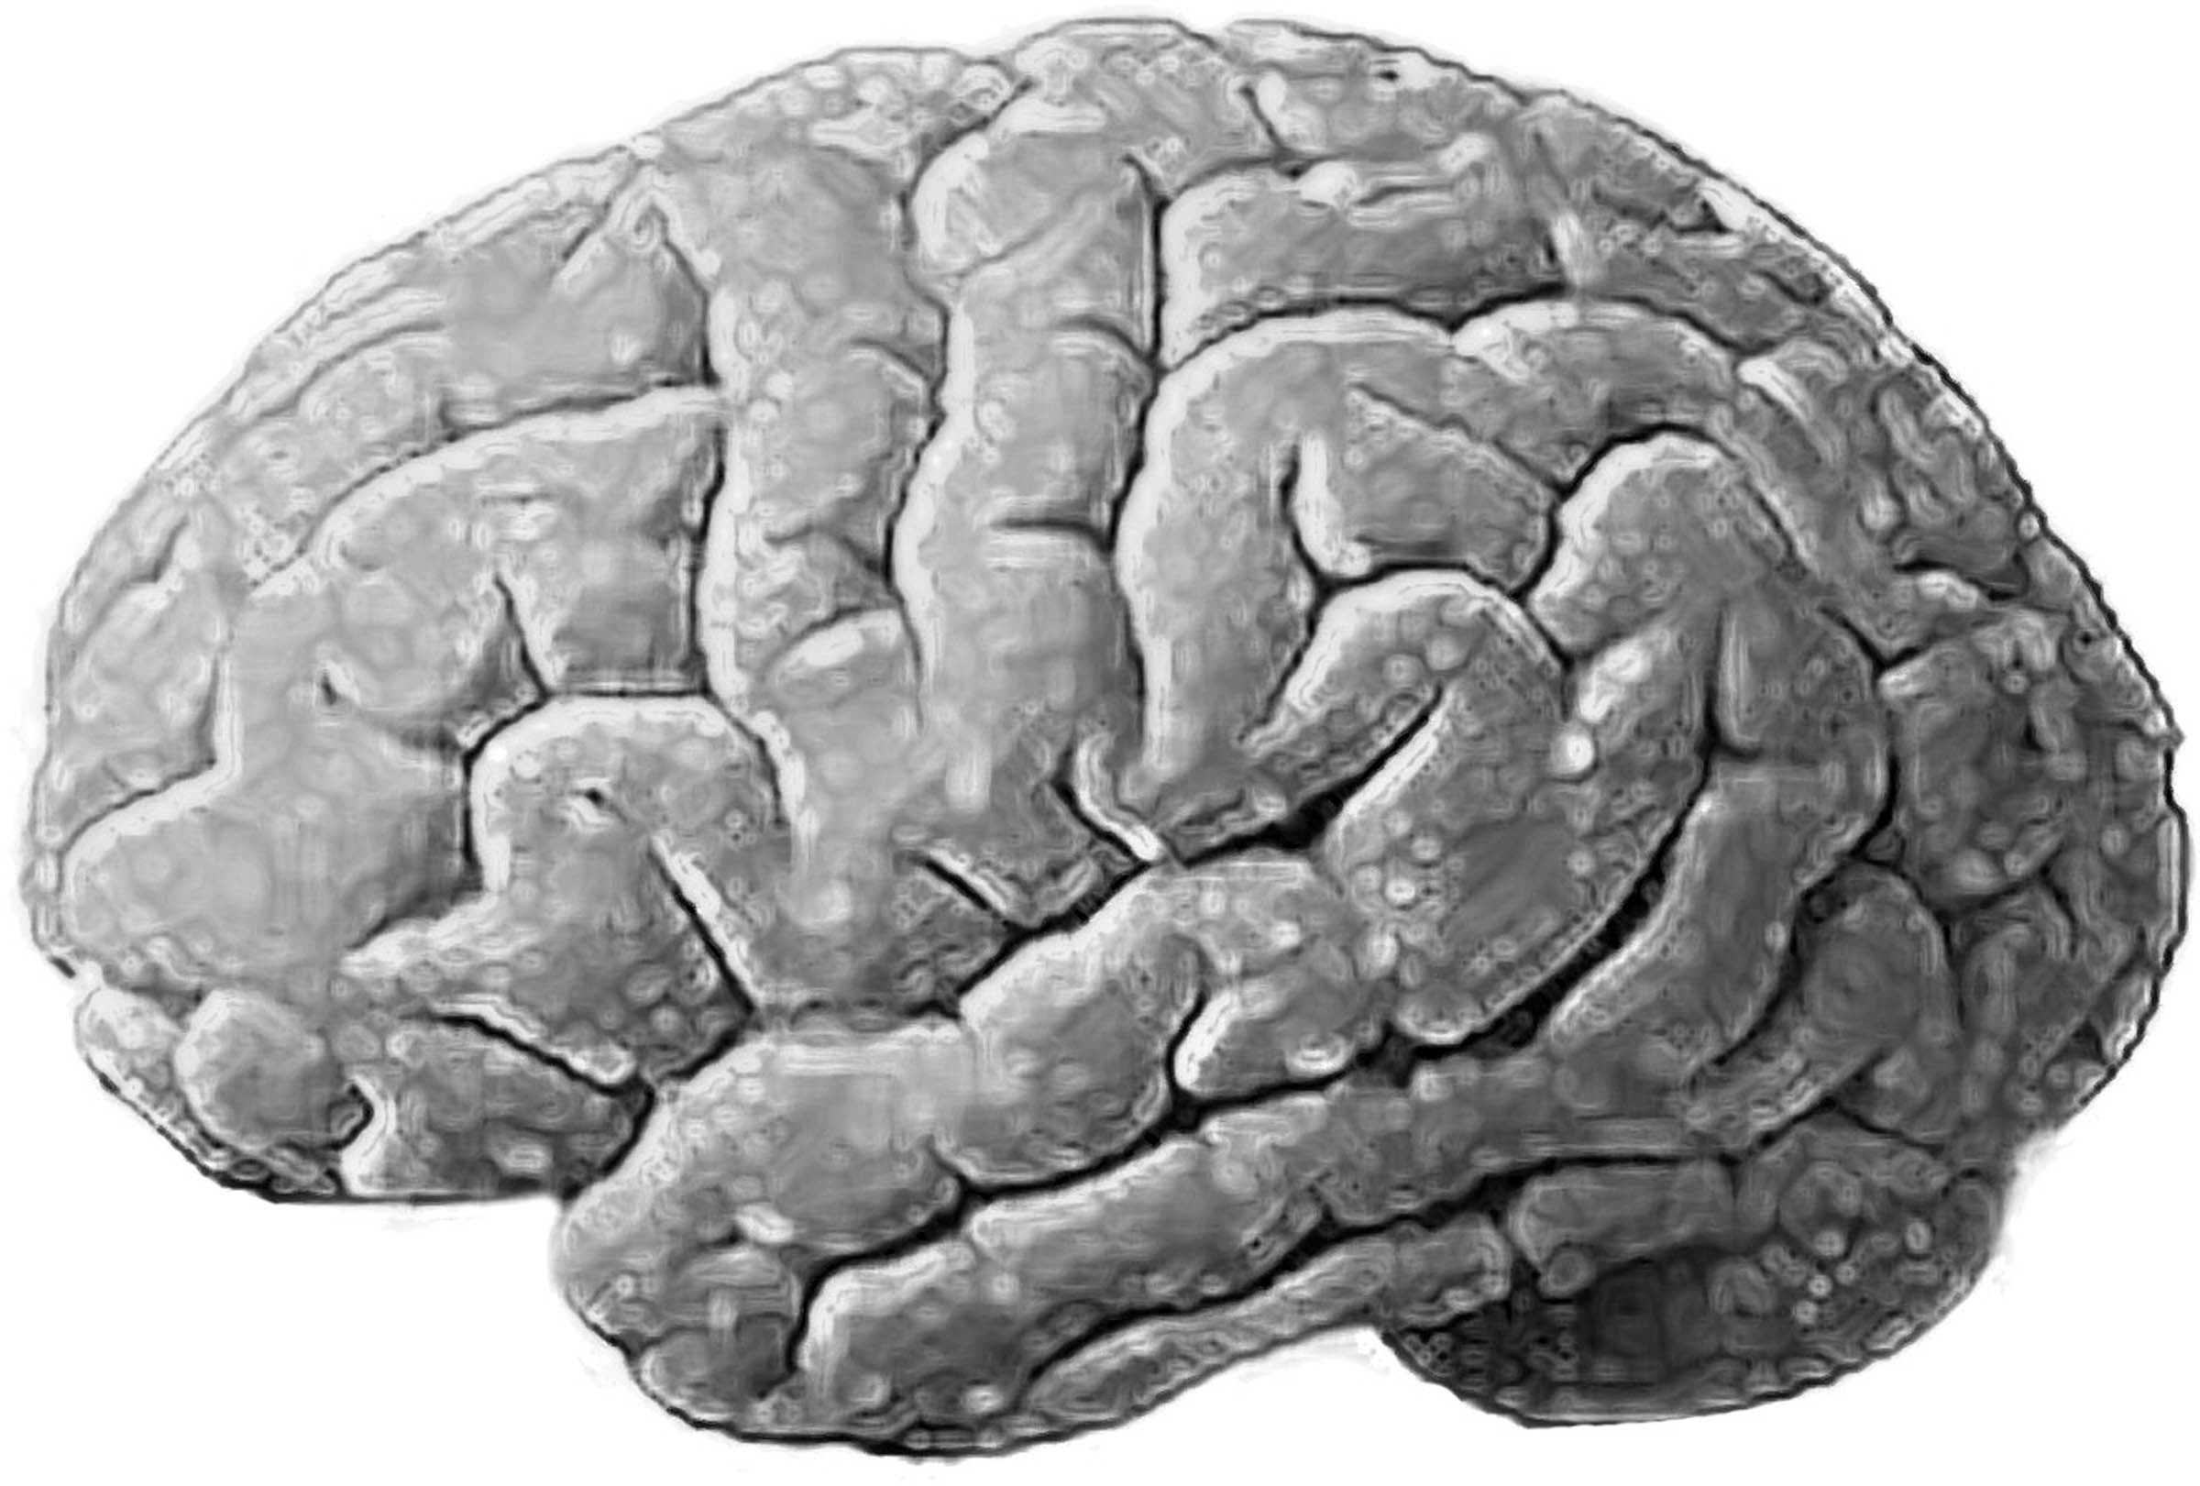
How many individual, emotional and indepth relationships can the social brain sustain?
150
752

Slide 3
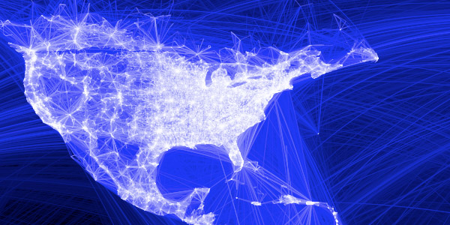
vs. face-to-face
Geographical representation of Facebook Relationships in North America
Facebook Usage
Social Skills
Peer Networking
Connecting with people of the same demographic
(age)
Interaction with Facebook
(How, How Much & Why)
600 Million
World-wide
Users
Messurable Interpersonal
Behavior

Slide 5
Literature Review
Methods
Social Assessment Tests
Preliminary Results
Conclusion

Slide 6
Literature Gap
Facebook
Vs.
Face-to-Face
Digital Social Behavior
Ψ
Implications on Social Life
Literature Review
Methods
Social Tests
Prelim Results
Conclusion

Slide 7
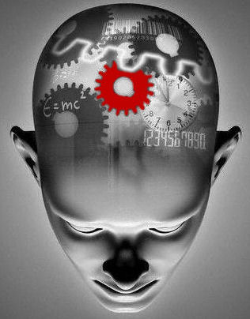
Facebook
Vs.
Face-to-Face
150 Cognitive Limit
Prescribed Relationships
Social Grooming
Literature Review
Online Identity Construction
Reputation Management
Online Social Awareness
Methods
Social Tests
Prelim Results
Conclusion

Slide 8
Online Questionnaire
Memorization
Survey
Recall
Facebook
Vs.
Face-to-Face
Typically, how much time per day do you interact with Facebook?
Do others consider you to be an outgoing person?
Do you believe your personality differs between Facebook and Face-to-face?
Are you more social on Facebook or Face-to-face?
How many friends do you have on Facebook?
Literature Review
Quantitative
Online Survey
Online
Tests
Social Desirability
Methods
Social Tests
Prelim Results
Conclusion

Slide 9
Interpersonal Skills
Facebook
Vs.
Face-to-Face
Name
Memorization
Conversation
Ability
Body Language
Comprehension
Face
Memorization
Language
Comprehension
Face Expression
Comprehension
Literature Review
Methods
Social Tests
Prelim Results
Conclusion

Slide 10
Facebook
Vs.
Face-to-Face
Correct Face (2 pts)
Incorrect Face (-1pt)
Literature Review
Methods
Social Tests
Prelim Results
Conclusion

Slide 11
Facebook Usage (per day)
Facebook
Vs.
Face-to-Face
Name Memorization
(Audio)
(9pts -3pts)
Face Memorization
(Video)
(3pts -10pts)
Friends
(575 – 963)
Literature Review
Methods
Club Inolvement &
Self-Percieved Outgoing-ness
Social Tests
Belief in
Creation of
Ideal-Self on Facebook
Prelim Results
Conclusion
Typicals
(30min – 1 hr)
Adicts
(2-3 hrs)
Crazies
(> 6 hrs)
Casuals
(< 30min)
Notes:
JOKE

Slide 12
Facebook
Vs.
Face-to-Face
"Socialness"
Facebook Usage
& Friend Count
Social Involvement
Social Confidence
Literature Review
Methods
Facebook Usage
Obsession of Image
Manipulation
Projection of Ideal Self
Social Tests
Prelim Results
Facebook is a Visual Experience
Stresses Certain abilities
Conclusion

Slide 13
System
Individual
Facebook shapes our social landscape and abilities
Certain social personalities are attracted to Facebook
Certain abilities are adept at Facebook

Slide 14
Questions

Slide 15
Correct Syllable (1pt)

